Slide 1
What is a Brand Equity??
Brand equity is a set of assets & liabilities linked to the brand name
Brand equity adds value to the brand name

Slide 2
The major asset categories of Brand Equity
  Brand awareness
  Brand loyalty
  Perceived quality
  Brand associations

Slide 3
Brand Awareness
Strength of a Brand’s presence in consumer’s mind
If consumer’s minds relate to each brand as a billboard then, the brand awareness relates to the size of that billboard
Brand recognition
Brand recall

Slide 4
Brand Recognition
Reflects familiarity gained by past exposure
It does not imply
  Where the brand was encountered before
  Why it differs from other brands
  What the brand’s class is
It is simply remembering that there was past
exposure to that brand

Slide 5
Metaphor of Brand recognition
A peanut butter…!!!
  Un named superior
  An inferior with a known brand
    73% of the customers inferred that the peanut butter with inferior quality but a known brand tastes better
The bottom line-
  Consumer perceives that if the brand appears before them time and again then the company must be spending a lot on the promotion it and it happens only if the quality of the product is very good

Slide 6
Brand Recall
Name a toothpaste
Name a mosquito repellant
Life insurance
Water purifier
Noodles
If the name of the brand automatically comes into the consumer mind if the products of same category are talked

Slide 7
Story of Intel-Inside
Intel was threatened by the invasions of AMD, Chips and technologies and Cyrix
Cooperative Advertising Allowance-
  If purchased intel processor-3%
  If used logo of intel processor-5%
How did it effect the bottom line????

Slide 8
Turn around
A budget expense of 100 M US D/year
Generated 90,000 pages worth of ads in an 18 months period which translated to exposure of 10 billion people
Recognition of intel increased from 46% to 80%
1993- The sale of intel grew upto 63%

Slide 9
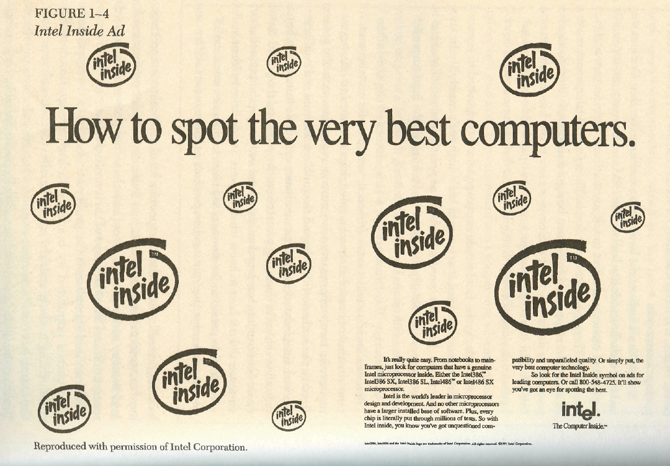

Slide 10
Brand Name Dominance
It is the ultimate level of Brand awareness
Brand name become common and can not be separated or legally protected
  DALADA,NIRMA, XEROX,
The brand should start protecting from the very beginning
  Xerox protected itself by tagging “Copier”
  “Jeep is a registered trademark of Chrysler”

Slide 11
Creating Brand Awareness
Consumer are bombarded with so many marketing messages .It is Challenging to establish Recall and Recognition by doing economically
A broad sales base is always an enormous asset
  Tata Product, Honda, Siemens ,Toshiba
Skillfully operate outside the normal media
  Standard Charter, DLF

Slide 12
Perceived Quality
  Perceived quality drives financial performance
  A strategic thrust
  A measure of “Brand Goodness”
  Creating perception of Quality

Slide 13
Financial performance
  Studies using PIMS data in US (annual data measuring more than hundred variables for over 3000 business units) have shown that perceived quality has direct impact on ROI than market share, R&D or making expenditure.
  National quality research center of Michigan has observed 77 firms for period of 5 years and they found that perceived quality has direct influence of ROi

Slide 14
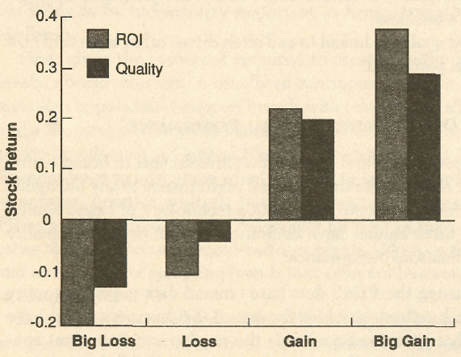
Stock Market Reaction to Changes in ROI and Perceived Quality

Slide 15
A strategic thrust (Tool)
Usually the goal of many a organizations for TQM programs and Six Sigma methodology is to create perception of quality
Many firms consider “Quality” to be one of the core value and include that into their mission statement

Slide 16
Quality as a measure of Brand Goodness
quality not only signifies goodness of brand but also it touches all aspects of brand

Slide 17
Creating perception of quality
Perceived quality may differ from actual quality for verity of reasons
Company may achieve quality that consumers may not find important, hence create quality in area where customer will notice it and appreciate it
  Citi Bank increased Back-Office efficiency
Consumer rarely have all the necessary information to make rational and objective judgments on quality
Ex . Assess sturdiness of Car by kicking tyre
Consumers may be looking at the wrong cues-they need to be educated (High price does not mean high quality)

Slide 18
Brand Loyalty
A brand without a loyal customer base is vulnerable
Brand loyalty relieves burden of marketing costs because retaining customer is cheaper than making new customer

Slide 19
Loyalty Segmentation
Non-customers-those who buy competitors brands
Price switchers-price sensitive
Passively Loyal- buy as a habit rather a reason
Fence sitters-indifferent to brands
Committed-Truly loyal

Slide 20
Brand association
Brand association helps a lot for creating brand equity
Brand association can be product attribute, a celebrity spoke person , particular symbol
Brand association is driven by brand identity i.e. what company wants their product to be in the minds of customers

Slide 21
Building Strong Brands is difficult
Pressure on compete on price-Sales promotion cost has gone high
Proliferation of competitors- Brand extension and private lables
Fragmenting media & complex brand strategies- Ad, sale promotion,PR, Public relation.event sponsorship, exhibition displays, YouTube, internet, influencer , etc.
Biased towards changing strategies
Biased against innovation
  HM Ambassador
Pressure to invest else where ( No focusing on core business)
  Vediocon

Slide 22
Measurement of Brand Equity
There are many ways to measure a brand.
Measurements approaches are at the
  firm level
  product level
  consumer level.

Slide 23
Firm Level
Firm level approaches measure the brand as a financial asset.
In short, a calculation is made regarding how much the brand is worth as an intangible asset.
Brand Equity=market capitalization - tangible assets and "measurable" intangible

Slide 24
Product Level
Difference in the value between generic product and branded product

Slide 25
Consumer Level
Perceptual mapping
Projective techniques

Slide 26
Projective technique
Word association :
Respondent is given series of words and asked to tell first thing which comes to his mind about that word
Time and frequency of the answer is most important parameter to know feeling of the person about that word
If some body does not give any answer it mean he is very emotionally involved in that thing it blocks him to respond

Slide 27
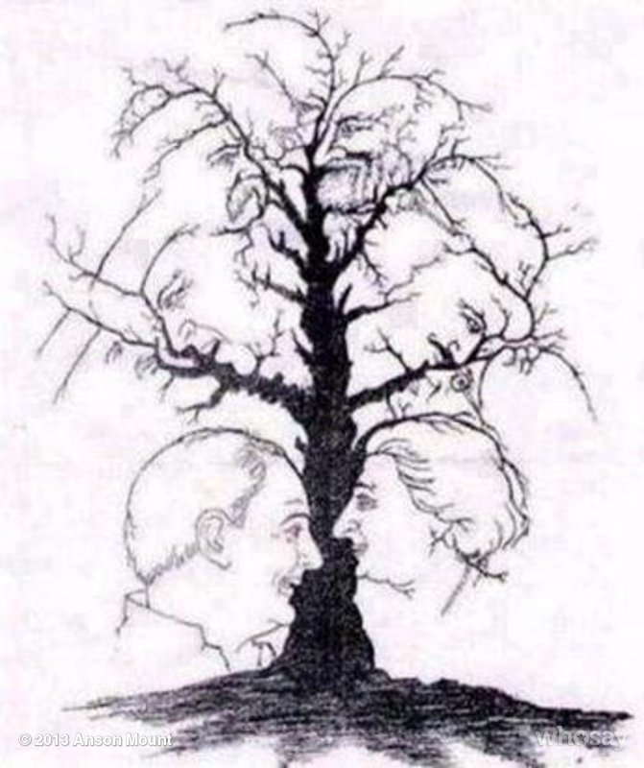
Story telling

Slide 28
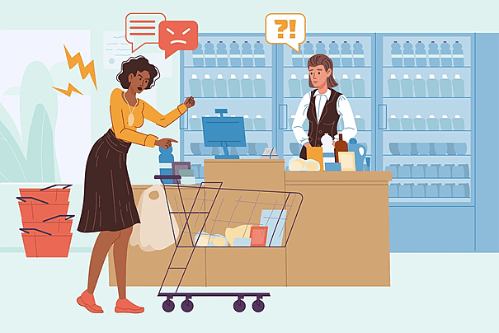
Sentence completion

Slide 29
Sentence Completion

Slide 30
Role play
Collage
Music association
Anthropromorphicizing

